Slide 1
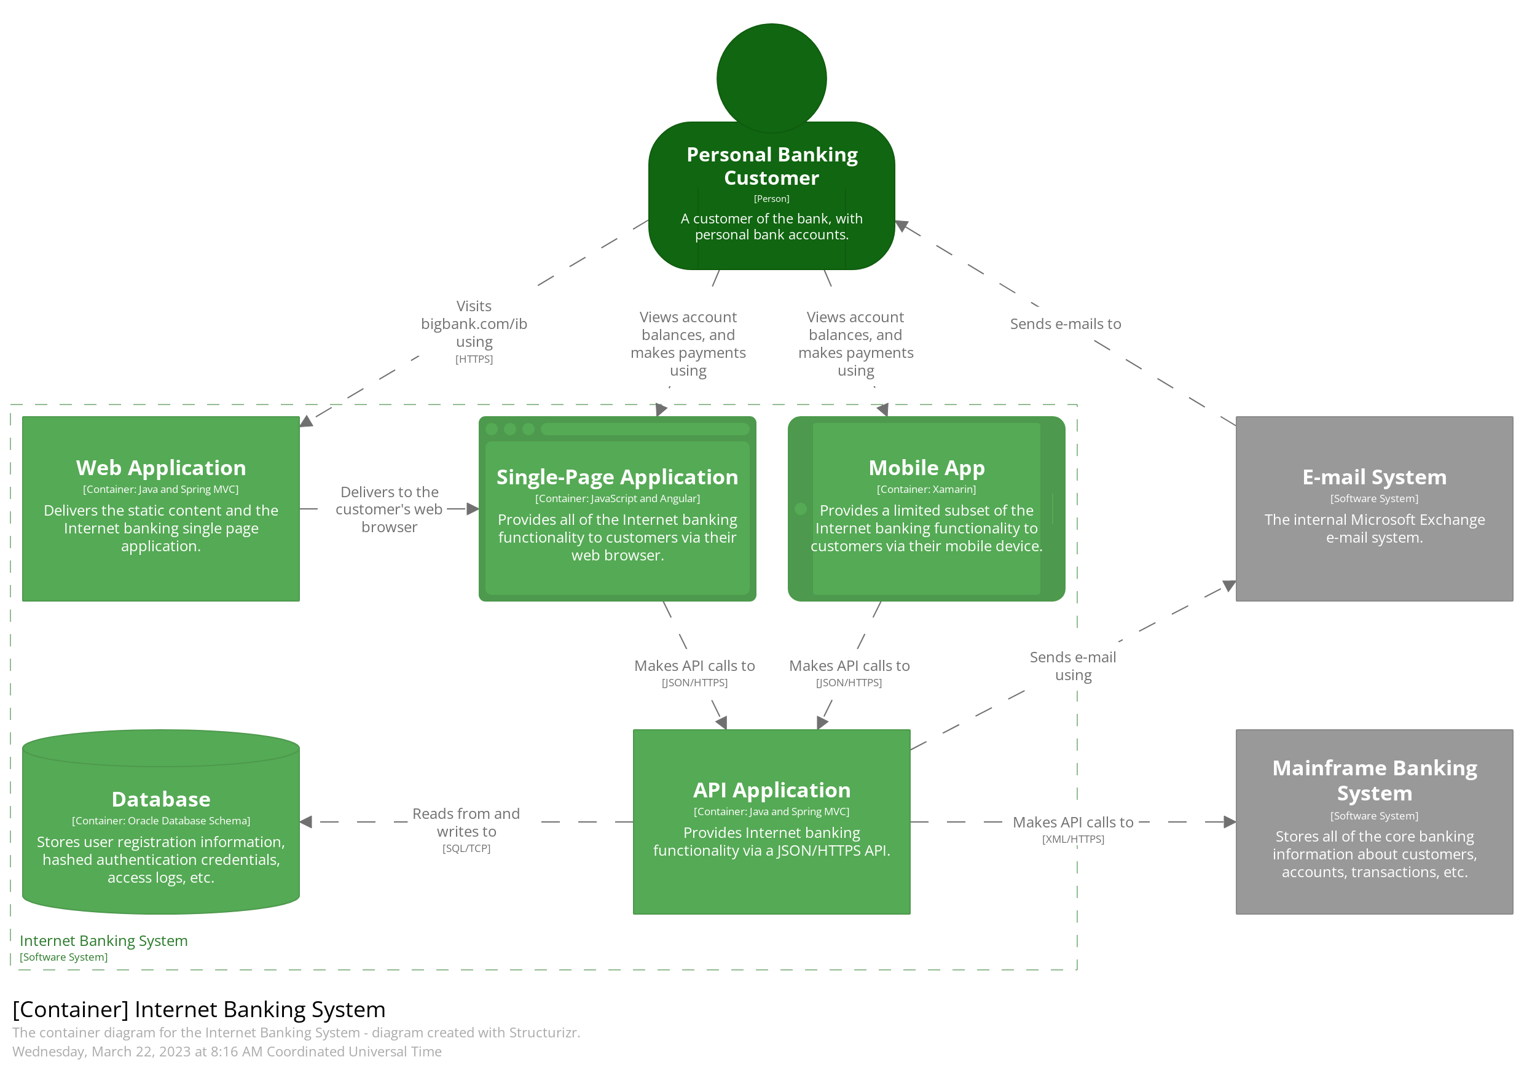
Notes:
Container

Slide 2
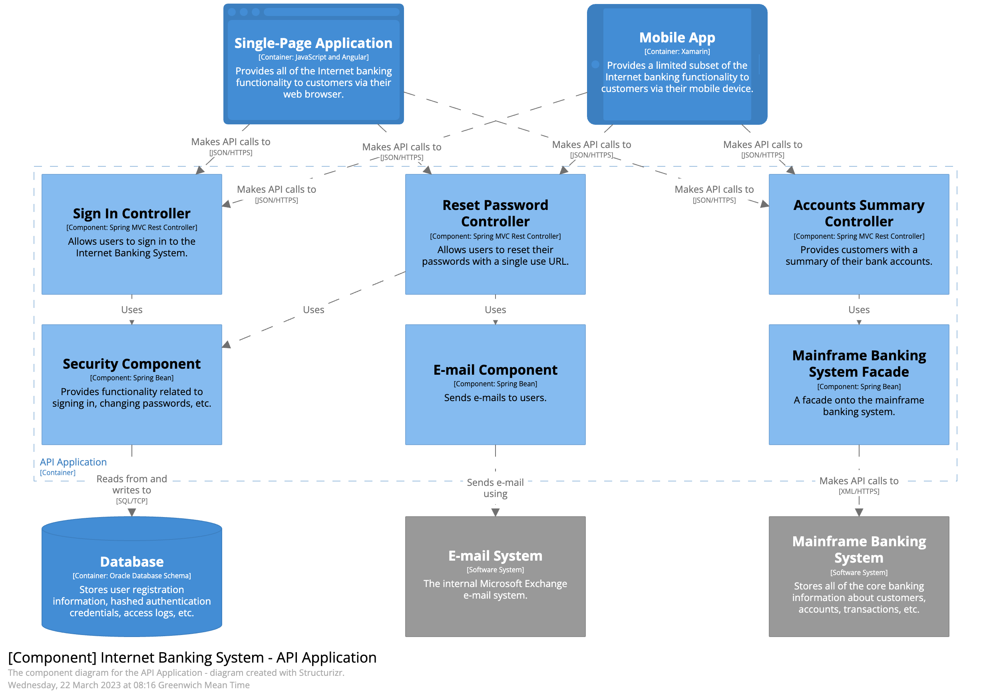
Notes:
Component

Slide 3
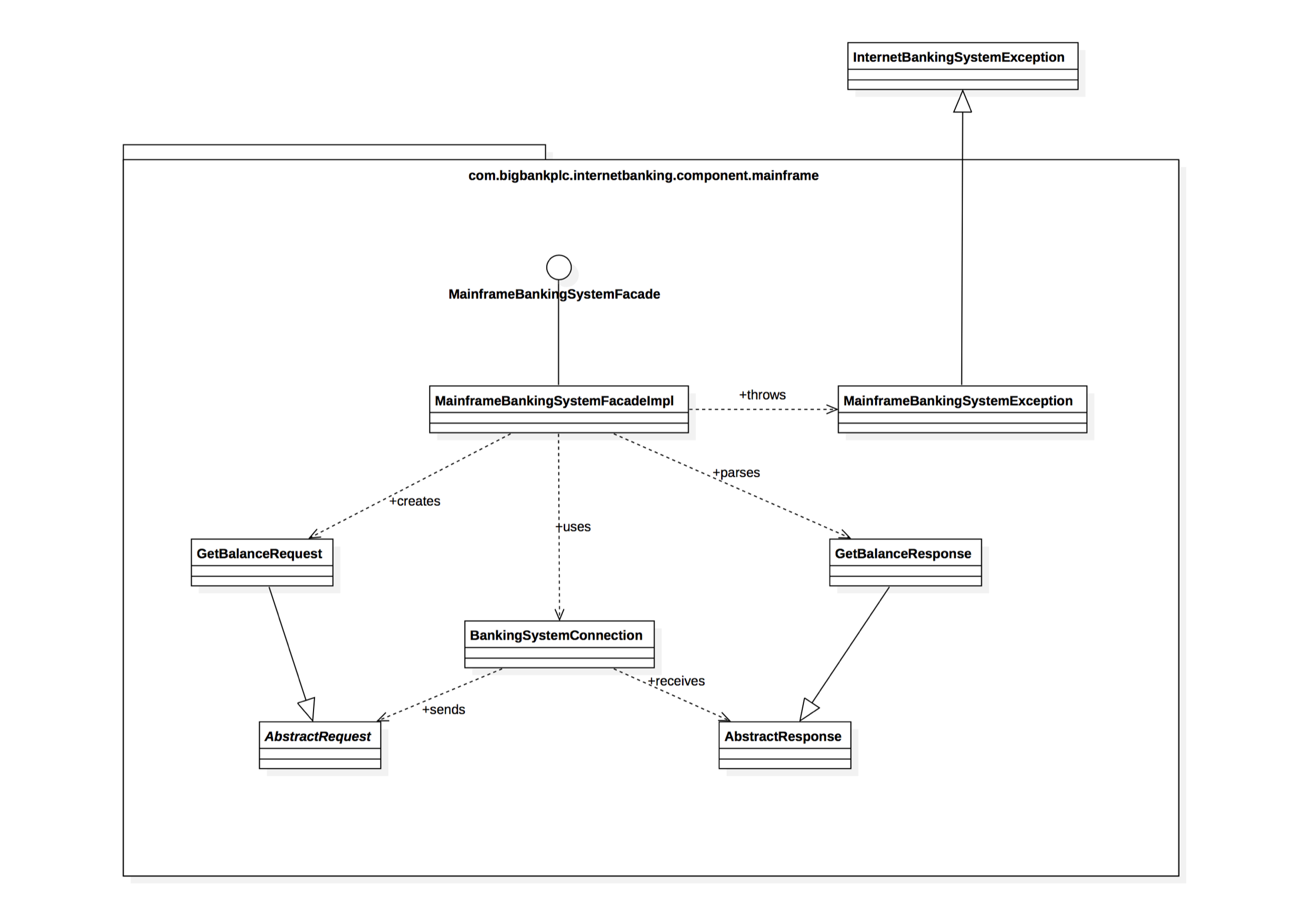
Notes:
Code

Slide 4
What’s the right scope? One that’s big enough to be meaningful, small enough to be comprehensible, and cohesive enough to make sense.
Instead of trying to make models right, you should think about whether your models are useful. To answer that question, though, you need to first know what the model’s use, or purpose, is. For a model to be useful, it needs to help you answer a question or make a better decision. Otherwise, your diagram is just art, and having looked at thousands of architecture diagrams, my impression is that most architects aren’t particularly gifted artists.
The Software Architecture Elevator
Gregor Hohpe

